Slide 1
DAC Network on
Development Evaluation
Illuminating development challenges and results

Slide 2
DAC Network on Development Evaluation
Mission: The overall mission of the Evaluation Network is to “contribute to better development results using evaluation to build a strong evidence base for policy making and for learning”.
To meet this objective, the Network works to :
  Advocate and share knowledge on best practice in evaluation.
  Synthesise evaluation evidence on key development topics and share findings and lessons.
  Work with developing country partners to increase collaboration and promote and support evaluation capacity development.
Participants: Main (central or independent) evaluation departments of DAC member countries, regional development banks, the IMF, the UNDP and the World Bank Group. Developing countries, civil society groups and other partners regularly engage on topics of mutual interest.

Slide 3
What is EVALNET?
Sharing experiences,
peer learning
Developing norms and guidance
Facilitating collaboration and joint evaluation
Knowledge management & linking to policy communities
Notes:
EVALNET is a forum for learning, strengthening members’ own policies and practices, and working together to support evidence-based policy making.
Aim of this slide is to give an overview of how the network functions
Sharing experiences, peer learning: the network provides an opportunity to meet and connect with colleagues who face similar challenges. Place for professional exchange and networking (example you gave about picking up the phone to call others)
Developing norms & guidance: support strengthening of evaluation policy and practice by developing agreed norms and standards. These provide shared basis for working together. Guidance work particularly in emerging/challenging areas. Ex: budget support methodology.
Knowledge management and linking to policy: the network provides a knowledge management function, notably bringing together evaluation knowledge from all the members on DEReC (online database of evaluations). Through the EVALNET, members’ work is disseminated into relevant policy communities in the DAC and beyond –multiplying your own dissemination efforts.
Facilitating collaboration: EVALNET is a leader in the area of joint evaluation, many major joint works have been done by members. Provides a platform for coordination, identifying shared interests.

Slide 4
Action points
What you can gain:
How you can contribute:
Benefit from involvement with a supportive community of peers.
Exchange ideas and get advice from other members.
Browse member plans to identify opportunities to work together and see how agenda is changing.
See how evaluation policies, methods and systems are evolving.
Draw on specific guidance work.
Find evaluation reports in sectors or topics of interest.
Connect with DAC policy agenda.
Engage actively in discussions and work programme.
Send us your evaluation plans and ideas.
Share reports for DEReC.
Keep your member profile page up-to-date.
Suggest topics or inputs for meetings and newsletters.
Participate in task teams or lead joint work, based on your own interests.
Notes:
Participation also enables members to see how the evaluation agenda is evolving, how systems are developing, the evolution in members policies and approaches, connect with the policy agenda in the DAC

Slide 5
The “DAC Approach” to Evaluation
Encourage evaluation to support critical thinking and put learning and accountability at the heart of development co-operation – not a straight jacket!
Evaluation principles (independence, credibility, use) provide basic guiding concepts for the set-up of an evaluation function.
Quality standards provide key benchmarks for the evaluation process and product.
Specific guidance provides direction and library of evaluation reports examples.
Encourage joint and collaborative evaluation, and support capacity development in partner countries.

Slide 6


The role of evaluation
Development evaluation is the systematic and objective assessment of a development programme or policy, its design, implementation and results.
Aim is to determine the:
Effectiveness
Relevance
Efficiency
Impacts
Sustainability
  Factsheet on Criteria (.pdf)
School children eating lunch. UNOCHA/Haiti 2011
Notes:
Evaluation is a key tool in efforts to improve accountability and performance of development programmes and policies.
Also refers to the process of determining worth or significance of a development programme or project.
Focus on use, not just evaluation for its own sake.
Main criteria: relevance, efficiency (resources to results), effectiveness (achievement of objectives), impacts (positive, negative, intended or not), sustainability.

Slide 7
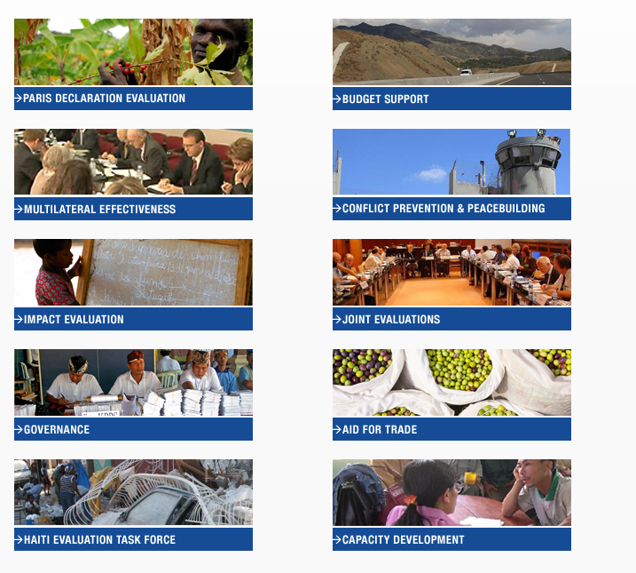
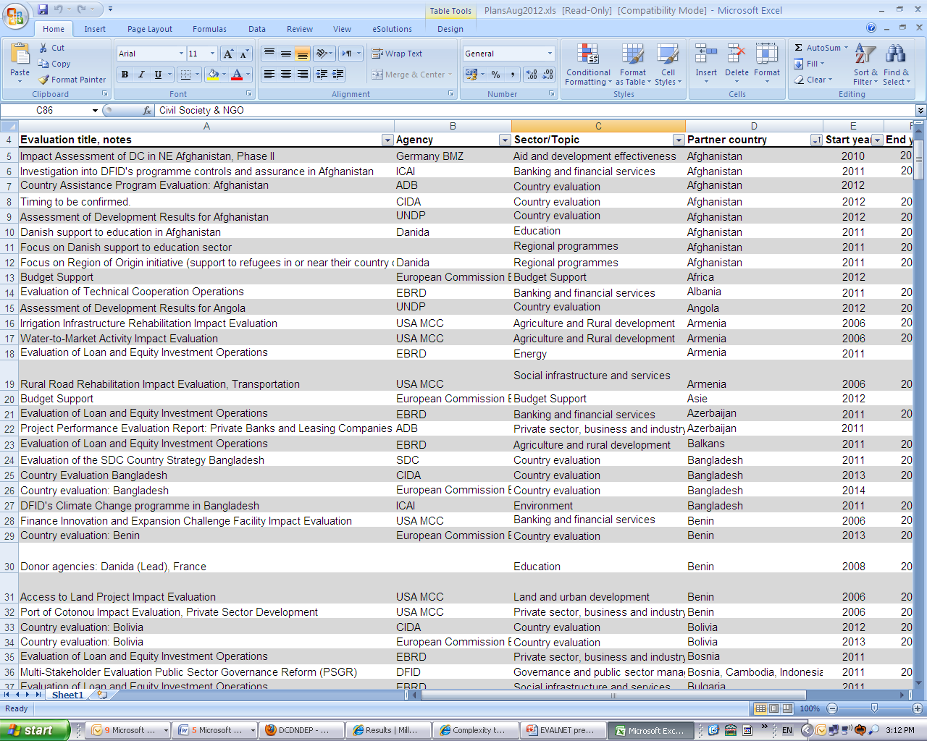
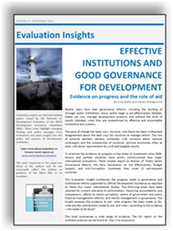

Current work: Some highlights
Notes:
Examples of different projects of the network, including resources for members

Slide 8

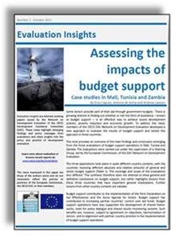
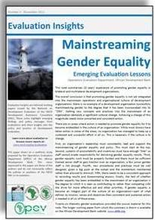
Evaluation Insights Series
Responds to policy needs for evaluation evidence
Widely disseminated: for example activities around World Water Week generated over 2,400 downloads in 2 weeks
  Please help disseminate!
Notes:
Insights notes are an opportunity to take stock of knowledge on a particular topic. Can be useful when you get an urgent request on a particular topic.
They are actively disseminated into relevant policy communities, providing greater visibility for evaluation findings. Not meant to replace individual evaluation report summaries.
Balancing need for credible, technically sound evidence with presenting it in a way that is intelligible to non-evaluators (telling the story).

Slide 9
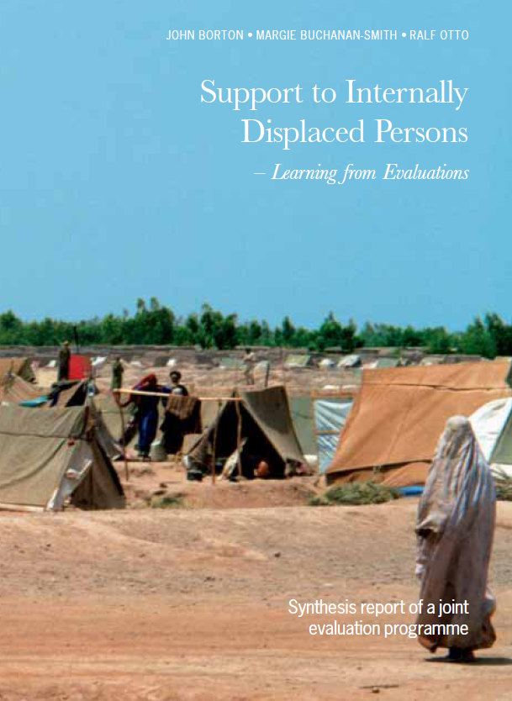
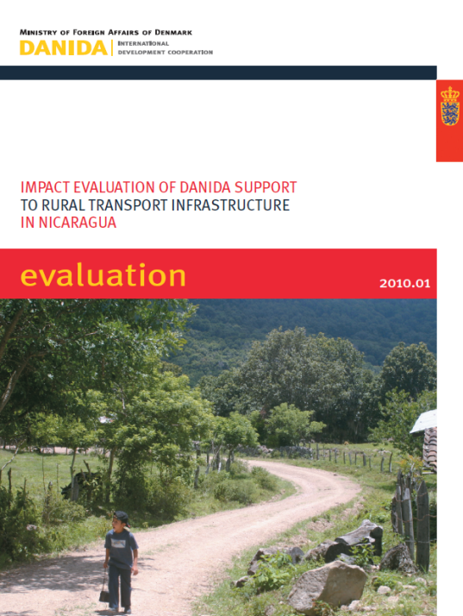
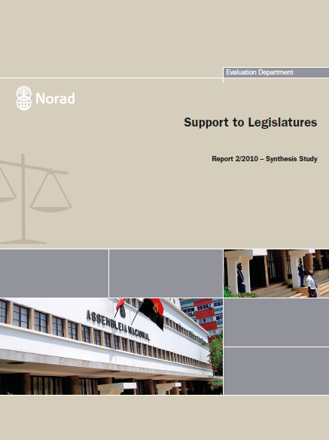
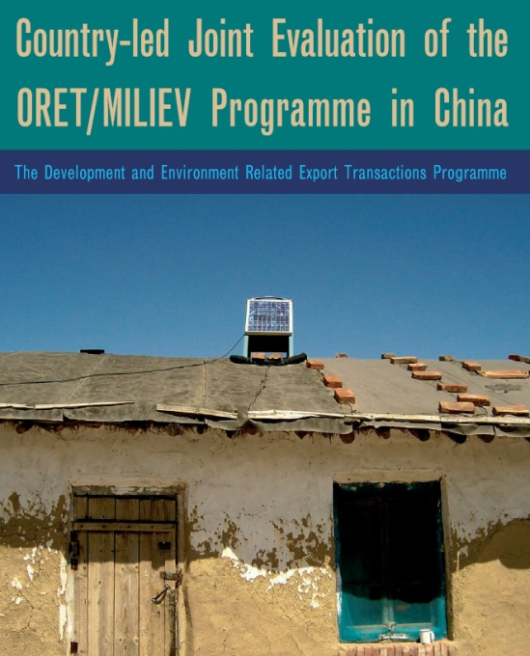
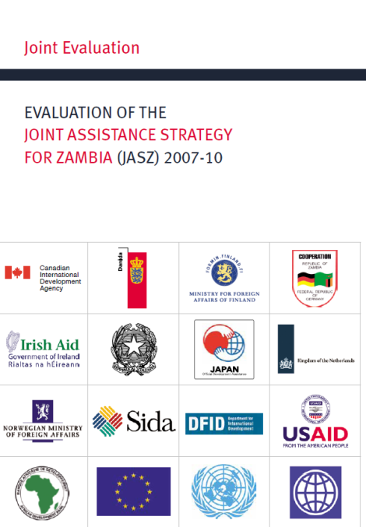
DEReC
DAC Evaluation Resource Centre
www.oecd.org/derec
Notes:
Now contains over 2000 reports, regularly updated. One stop shop for evaluation reports!
Useful to: Look at what others have done on a topic, see examples of ToRs, evaluation questions, etc.
Members should share evaluations regularly (as part of their dissemination/publishing process).
Please include abstract, key words, sector, recipient country clearly to facilitate categorisation.
(Some members not included because we do not receive and cannot find any published evaluation reports from your agency)

Slide 10



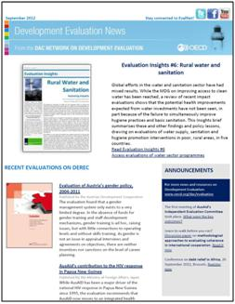
Thank you!
Visit and follow us at:
www.oecd.org/dac/evaluation
www.twitter.com/oecd_evalnet
2,200 followers; average 10 Tweets per week
www.facebook.com/EVALNET
4,300 fans; 2 posts/week average
http://www.youtube.com/user/OECDEvalNet
6,625 video views; 37 videos
Bi-monthly Newsletter to about 1500 people
Notes:
The Secretariat can help disseminate your evaluation reports – just send us the report (for DEReC) and let us know some key messages or if there is a related event you would like to link to!

